Slide 1
Movie Revenue Prediction and visualization of the available data
Milan Jolly - 1601CS25
Naveen T - 1601CS55

Slide 2


Overview
Large amount of data related to movies is available online on sites like kaggle ,IMDb and TMDb to name few.

Slide 3

2. With the help of this vast amount of data, we are finding relationships between the success of the movie and cast/crew along with an implementation to predict the revenue.

Slide 4
Current Implementations
Using linear regression model and a dataset which contains the following features:
Name, Year, Date, Genre, Wins, Awards, Nominations,
Budget, International/National.
The accuracy obtained with this
implementation is roughly 68%.

Slide 5
2. Using Deep Neural Networks Model and IMDb dataset:
(Name, rating, genre, budget, revenue), along with the movie poster.
The accuracy obtained is 52%.

Slide 6
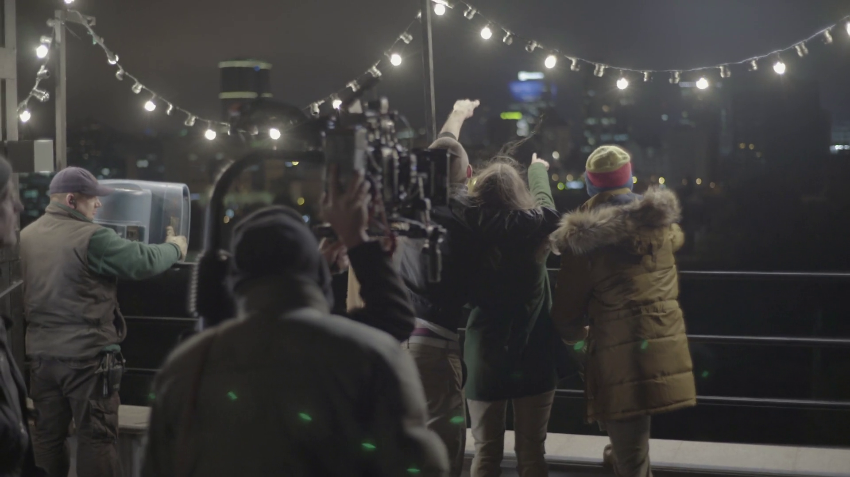
Novelty
Unlike most of the current implementations, we are giving high emphasis on the cast and crew for the movies.
Also with the help of DNN, we are going to also give importance to the fact that what kind of combination of cast and crew grouping leads to the betterment of the movie.

Slide 7



Along with this we are considering the impact of a particular grouping of genres and establishing a relationship between the success of genres and the month on which the movie is released.
+
=

Slide 8


Progress so far
The first task at hand was data-preprocessing. We used python to serve the purpose. The library used are: numpy, matplotlib, pandas, ast, operation.
There were some columns like the cast/crew data which were in JSON format and were converted into python lists for future operations.

Slide 9
DATA VISUALIZATION
Then we did some data visualization on the available data using bar charts and word cloud.
Implementing this came with more efforts as the data was not well arranged for some operations.
The below are some bar charts implemented by us:

Slide 10
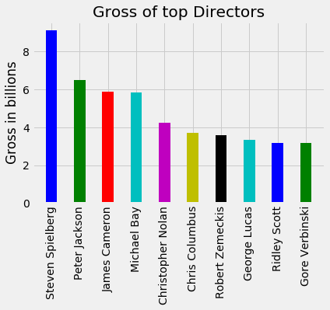

Slide 11
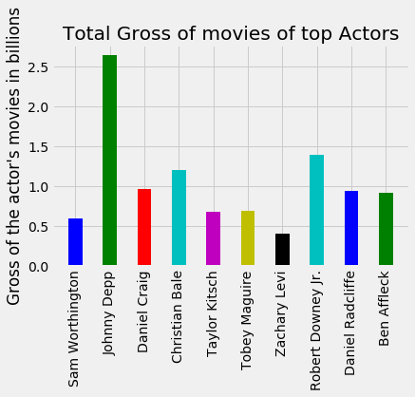

Slide 12
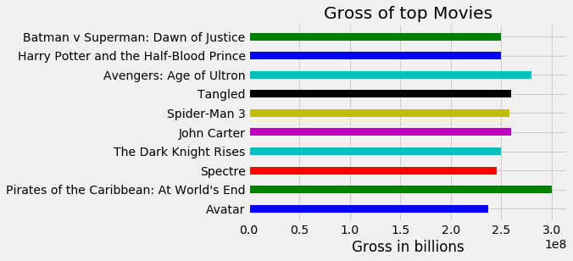

Slide 13
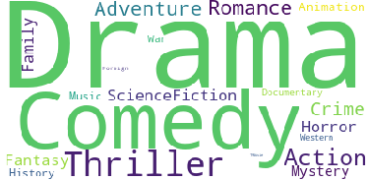
Below is a word cloud of genres where the size of a particular genre depicts its popularity

Slide 14
Timeline :
1 / 3 / 2018 --- Understand the logistic regression and classification learning algorithms. And get to know the tools to use them.
8 / 3 / 2018 --- Build the first model based on logistic regression considering the movie revenue as a continuous variable and then as a classification problem. Try to improve the accuracy by selecting appropriate features.
15 / 3 / 2018 --- Then we move on to SVM ’s. Understand them better and build an SVM model and compare the accuracy that we got previously and try to improvise it.

Slide 15
22 / 3 / 2018 --- In this week we still continue to work with SVM and try different ensembling techniques to improve the accuracy.
29 / 3 / 2018 --- Then, we plan to use neural networks to try out more complex relations between the input features to get a better accuracy.
1 / 4 / 2018 --- This week will be dedicated to make some modifications to the previous build algorithms and improvise them.

